Slide 1
Aims of the class (ciljevi časa):
Key vocabulary: Unit 3 – Retailing (New Insights into Business, str. 25)
Used to vs. be/get used to + ‘ing’
Tenses – Revision
Locating objects
Vocabulary development

Slide 2
Unit 3. RETAILING
Source - New Insights into Business, page 25
Listening, Track 11
SHOPS/
STORES
OUTLETS
RETAILERS
RETAILING
RETAIL CHAINS
SHOPPING CENTRES (US MALLS)
RETAIL PARK
HYPERMARKETS
SUPERSTORES
DEPARTMENT STORES

Slide 3
Fill in the gaps with the keywords given below:
DEPARTMENT STORES, RETAILERS, STANDARDIZED, LOCATION, OUTLETS, SHOPPING CENTERS, CHAINS, RETAILING, RETAIL PARK
_______________ is the business of selling products to the general public. Most _______________ sell from shops or stores, which are called _______________. Many countries have large retail _______________ , which are organized nationally and sell _______________ selection of products. Their outlets are often in _______________ (US malls), where there is a large variety of stores in the same _________________________.
Many large retailers operate from out of town locations with parking facilities, known as either hypermarkets (over 30,000 square metres) or superstores (under 30,000 square metres). They may be on a _______________, where there are a number of large stores.
__________________ such as Harrods in London are large shops, which sell a wide variety of products, usually from a city center location. As the name suggests, they are organized in departments, each with its own manager.
RETAILING
RETAILERS
OUTLETS
CHAINS
STANDARDIZED
SHOPPING CENTRES
LOCATION
RETAIL PARK
DEPARTMENT STORES

Slide 4
Connect the words with their definitions.
department stores
retailing
superstores
hypermarkets
retail chains
over 30, 000 square meters
organised nationally, sell a standardised selection of products
the business of selling products to the general public
under 30, 000 square meters
large shops, sell a wide variety of products

Slide 5
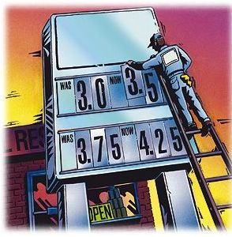
Retail Sales Phrases
Answer the questions. Choose between a), b) or c).
Which of the following persons does not work at a shop? ..........
(a) A cashier
(b) A shop-assistant
A window shopper
Which of the following phrases is not a good way to greet a customer? .........
(a) Hi, what's going on today?
(b) Good afternoon, sir. May I help you?
Good morning. What would you like, ma'am?
Customer: "Excuse me. Could you tell me where the coffee is?"
Sales clerk: "Certainly, it's in the next aisle opposite ......... the bread."
(a) at
(b) /
(c) from

Slide 6
Retail Sales Phrases
Answer the questions. Choose between a), b) or c).
Customer: "Good morning. I need some tissues."
Sales clerk: "Of course, how ......... packets would you like?“
(a) many
(b) lots of
much
If you think this is too big, we have a ......... size too.
(a) lesser
(b) bigger
smaller
You will find meat and sausages ......... next door.
(a) by the butcher's
(b) at the butcher's
(c) for the butcher's

Slide 7
Retail Sales Phrases
Customer: "Excuse me. When do you close today?" Sales clerk: "We close ......... 10 o'clock."
(a) for
(b) to
at
Would you like to pay cash or ......... credit card?
(a) by
(b) on
to
Thank you, here is your change and your ..........
(a) recipe /resƏpi/
(b) receipt /rIsi:t/
(c) recheck
Answer the questions. Choose between a), b) or c).

Slide 8


Recipe/resƏpi/, a medical prescription and receipt /rIsi:t/
Pročitajte tekst i pokušajte da prevedete i objasnite značenje reči „recipe“.
“Tracing the origin of this word, one visualises spice cupboards, kitchens, chefs notebooks, even TV dinners. More surprisingly perhaps, we're also transported to medicine cabinets and apothecary's shops. The word derives from the Latin verb recipre, meaning to receive. As this OED* entry tells us, recipe appears to have entered the English language in the 1400s. At this time it was common for physicians to place the word recipe (the 2nd person singular imperative of the verb recipere) at the top of prescriptions, before listing the ingredients that the patient should 'receive' for his or her medical remedy. Amazingly, the first citation for the word in relation to cookery is as late as 1716. “
Source (izvor): British Library . http://www.bl.uk/learning/langlit/dic/oed/receipt/recipe.html (Web)
*OED=Old English Dictionary, rečnik staroengleskog

Slide 9
recipe = the instructions for cooking or preparing something to eat; a medical prescription (recept)
receipt = a piece of paper given to show that you paid for something (račun)

Slide 10
DVD projection: The future of shopping : Malleable malls Source: The Economist (Feb 16th, 2013)
Comprehension questions.
Why did many firms give up their high street shops in Britain?
What caused the changes in the retailing strategy?
How do you understand the term: jazzier outlets? (colloq.)
Shopping online increased by: a) 60%
b) 16%
Due to recession, tough market conditions.
High property taxes and weak consumer spending.
Outlets are becoming more and more fancy & flashy.

Slide 11
DVD projection: The future of shopping : Malleable malls Source: The Economist (Feb 16th, 2013)
What do shopping centers offer?
What is the problem with this selling experience and shopping malls in general?
They offer a lot of floor space, cheap or free car-parking, they attract customers “promising a big day out”, offer plenty of things to do…
People get used to it. There is always somewhere newer to go.

Slide 12
Used to vs. be/get used to + ‘ing’
They may look similar, but are completely different!
More on this: New Insights into Business, pgs. 39, 166

Slide 13
Used to
things that happened in the past but don’t happen anymore
We used to live in London when I was a kid.
I used to go dancing every Thursday when I was at school.
the negative is ‘didn’t use to’ and questions are formed with ‘Did you use to …?’

Slide 14
be/get used to + ‘ing’ or noun
if you are used to (doing) something, you are accustomed to it – you don’t find it unusual anymore
I’m used to getting up early.
I’m used to speaking in English during my Business English classes. ☺
He’s not used to the weather here yet. He’s finding it very cold.

Slide 15
Practice, USED TO vs. BE USED TO (-ING/NOUN)
Fill the gaps with one of the phrases: USED TO vs. BE USED TO (-ING/NOUN) in the correct form.
I _______________ work in a bank but I left and got a job as a gardener.
I ______________ like coffee. I don’t like it now.
You ____________________ smoke! When did you start?
The noise was deafening but the driver ____________________ it.
When I was young we _________________ live in a big house in the countryside.
I _______________ living in such a small flat and I found it really hard at first.
USED TO
USED TO
DIDN’T USE TO
WAS USED TO
USED TO
WASN’T USED TO

Slide 16
Practice, USED TO vs. BE USED TO (-ING/NOUN) – next class!
Complete the following sentences by combining the verb in brackets with the appropriate form of used to or (be used) to + ing.
If you’re used ____________________ (have) money, it’s hard to be without it.
I’m used ____________________ (drive) in London.
Aren’t you used ____________________ (walk) so far?
I ____________________ (like) meat. Now I prefer fish.
Sean’s used ____________________ (deal) with difficult kids.
Penny ____________________ (play) badminton. Now she plays golf.
I’m not sure where to turn. I’m not used ____________ (come) this way.
Claire ____________________ (live) in Scotland. Now she lives in Ireland.
to having
to driving
to walking
used to like
to dealing
used to play
to coming
used to live
Selection of sentences from:
Swan, M. & Walter C. (2011) OXFORD English Grammar Course

Slide 17
Tenses (revision) – next class! Put the verbs in brackets into the correct tense: Present Simple, Present Continuous, Past Simple, Present Perfect.
sent
Last year my firm ______________ (send) me to Japan.
What time ______________ they ______________ (leave) the station yesterday?
The train ______________ from Waterloo at 17.59 . (leave)
He ______________ (work) as a consultant in Madrid this month.
I ______________ (not be) on a training seminar since 2008.
A good leader always ______________ (inspire) the team.
We ______________ (discover) the problem last night.
This is the first time we _________ ever_______________ a complaint. (receive)
A: Is Mr. Bohr here yet?
B: Yes. He _________________ for us in reception. (wait)
did
leave
leaves
is working
have not been
inspires
discovered
have
received
is waiting

Slide 18
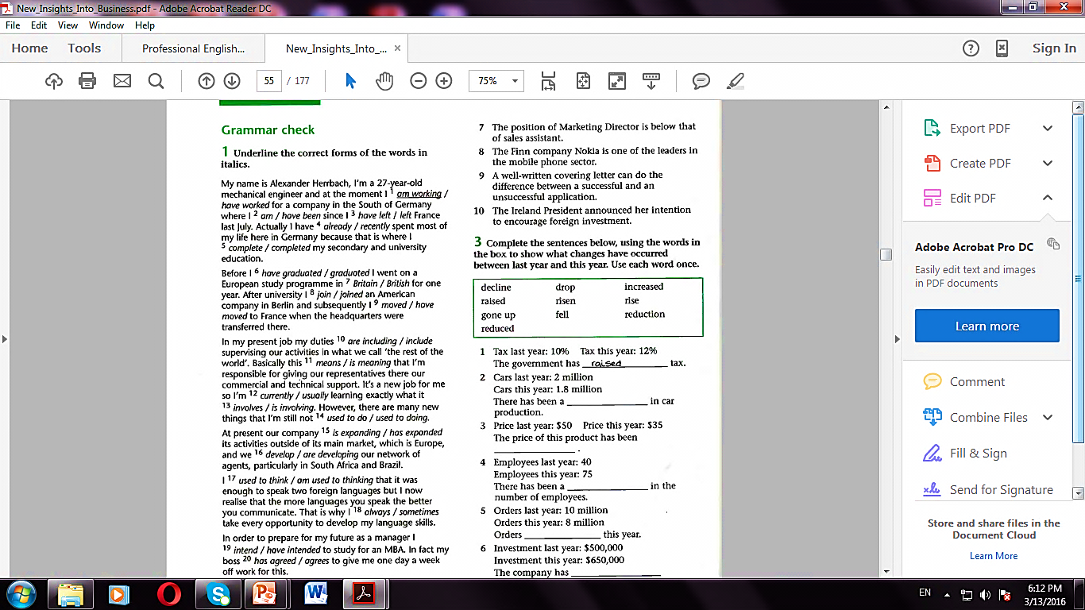
Grammar Check – New Insights into Business, p. 54
CHOOSE THE CORRECT FORMS OF THE WORDS IN ITALICS.
TENSES REVISION: PRESENT PERFECT, PAST SIMPLE, PRESENT CONTINUOUS, PRESENT SIMPLE
TIME ADVERBS – VREMENSKI PRILOZI
USED TO vs. BE USED TO + VERB + ING

Slide 19
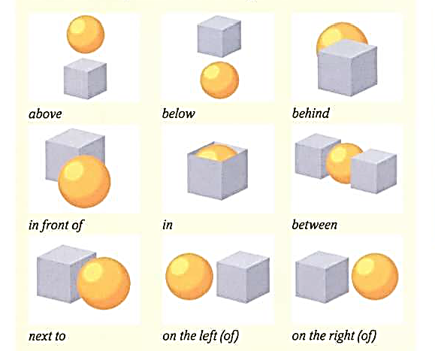
Locating objects

Slide 20
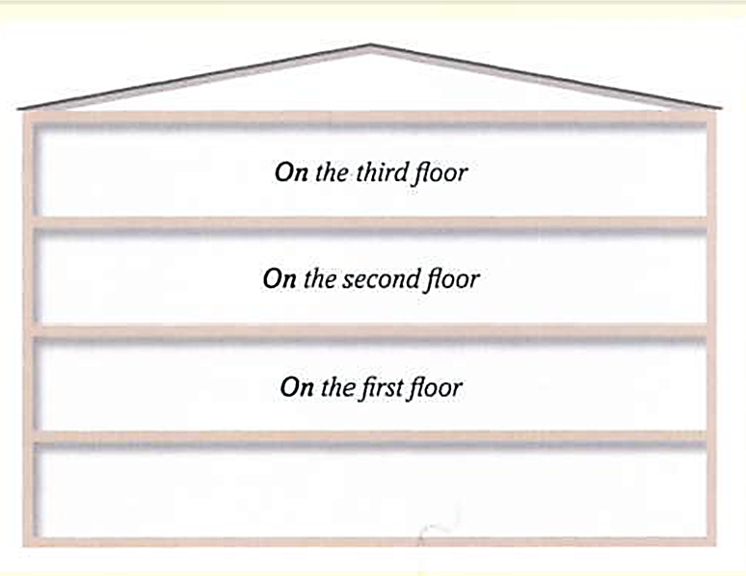
Locating objects
Do you know British equivalents?
US English
first floor
elevator
restroom
UK English
ground floor
lift
toilet

Slide 21
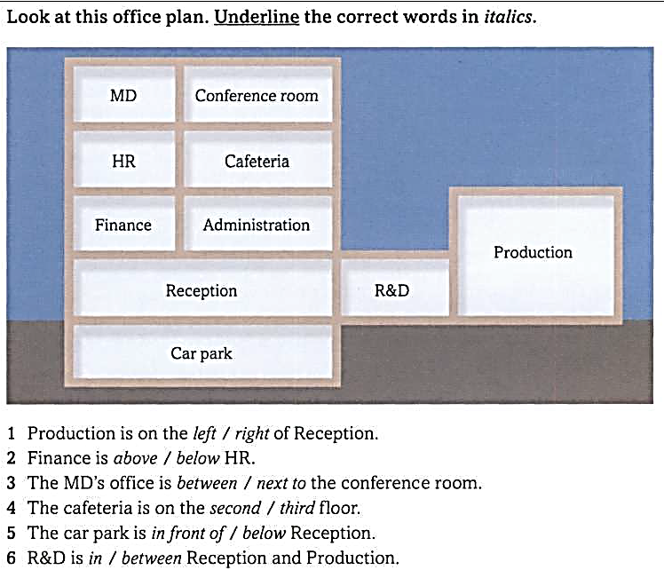

Slide 22
Vocabulary development: compound nouns - složenice
Match the noun from each sentence to form a compound noun.
Example.
She faces ​long ​hours and extreme ​pressure in her ​position as the ​top decision-________ in the ​company.
a) maker b) solver c) programmer
They are risk-________ who either make a lot of ​money or ​lose a lot.
solvers b) takers c) earners
Wage ________ is a ​person who ​works at a ​job for ​money.
shooter b) taker c) earner
Trouble-________ is a ​person whose ​job is to solve problems for a ​company or an ​organization.
shooter b) taker c) earner

Slide 23
Vocabulary development: compound nouns - složenice
Match the noun from each sentence to form a compound noun.
Example.
She faces ​long ​hours and extreme ​pressure in her ​position as the ​top decision-________ in the ​company.
a) maker b) solver c) programmer
Customer ________ is the ​part of an ​organization that ​answers ​customers' ​questions, ​exchanges ​goods that are not ​satisfactory...
power b) service c) goods
The ​purchasing________ ​of the ​dollar was much greater in the 1960s than now.
power b) service c) goods
Sales ________ represent the ​value or ​amount of the ​total ​sales of an industry's or company's ​products for a particular ​period.
margin b) figures c) goods
Profit ________ is the ​difference between the ​total ​cost of making and ​selling something and the ​price it is ​sold for.
margin b) figures c) goods

Slide 24
Thank
You for your attention! See you next class!
Notes:
Thank You (Basic) To reproduce the video effects on this slide, do the following:
On the Home tab, in the Slides group, click Layout, and then click Blank.
On the Insert tab, in the Media group, click Video, and then click Video from File.
In the left pane of the Insert Video dialog box, click the drive or library that contains the video. In the right pane of the dialog box, click the video that you want and then click Insert.
Under Video Tools, on the Format tab, in the Sizing group, click the arrow to the right of Size launching the Format Video dialog box, select Size from the left pane and under Size in the right pane do the following:
Click the Lock Aspect Ratio box.
In the Height box, enter 6.03”.
In the Width box enter 8.03”.
Also in the Format Video dialog box, click Border Color in the left pane, under Border Color in the right pane select Solid Line, and then click the arrow to the right of Color, and under Theme colors select Black, Text 1, Lighter 25% (fourth row, second option from left).
Also in the Format Video dialog box, select Border Style in the left pane, under Border Style in the right pane set the Width to 15 pt.
Also in the Format Video dialog box, select Shadow in the left pane, under Shadow in the Right pane, click the arrow to the right of Colors and under Theme Colors, select Black, Text 1 (first row, second option from left), and then do the following:
In the Transparency box, enter 60%.
In the Size box, enter 100%.
In the Blur box, enter 21 pt.
In the Angle box, enter 40 degrees.
In the Distance box, enter 19 pt.
Also in the Format Video dialog box, select 3-D Format in the left pane, under Bevel in the right pane click the arrow to the right of Top and under Bevel, select Relaxed Inset (first row, second option from left), and then do the following:
To the right of Top, in the Width box, enter 6 pt.
To the right of Top, in the Height box, enter 16.5 pt.
On the Home tab, in the Drawing group, click Arrange, point to Align, and then do the following:
Click Align Center.
Click Align Middle.
Under Video Tools, on the Playback tab, in the Video Options group, select Loop until Stopped.
On the Animations tab, in the Animation group, select Play.
On the Animations tab in the Timing group, click the arrow to the right of Start and select With Previous.
To reproduce the text effects on this slide, do the following:
On the Insert tab, in the Text group, click Text Box, and then on the slide drag to draw a text box.
Type text in the text box (“Thank You” – or whatever text suits your message).
Select the text, on the Home tab, in the Font group, select Garamond from the Font list, select 88 pt from the Font Size list, and then click on the Bold icon.
Also in the Home tab, in the Font group, select the arrow to the right of the Font Color Icon, and then under Theme Colors, select White, Background 1 (first row, first option from left).
With the text box selected, under Drawing Tools, on the Format tab, click the arrow in the bottom right corner of the WordArt Styles group, click the arrow opening the Format Text Effects dialog box.
In the Format Text Effects dialog box, click 3-D Format on the left pane, under Bevel on the right pane, click the arrow next to Top and under Bevel select Relaxed Inset (first row, second option from left). Set the Width to 5 pt and the Height to 3 pt.
Also in the 3-D Format right pane, under Surface, click the arrow next to Material and under Special Effect select Dark Edge (first row, first option from left).
Also in the 3-D Format right pane, under Surface, click the arrow next to Lighting and under Neutral select Soft (first row, third option from left).
Also in the 3-D Format right pane, under Surface, set the Angle to 290 Degrees.
Close the Format Text Effects dialog box.
To reproduce the background effects on this slide, do the following:
On the Design tab, in the bottom right corner of the Background group, click the arrow at the bottom right corner launching the Format Background dialog box.
In the Format Background dialog box, select Fill in the left pane, and under Fill in the right pane select Solid fill, then click the arrow to the right of Color and under Theme Colors select White, Background 1, Darker 50% (sixth row, first option from left).
Close the Format Background dialog.

