Slide 1
REVISION

Slide 2
Grammar reference, page 150

Slide 3
Grammar reference, page 150

Slide 4
Workbook, page 26

Slide 5
Solutions

Slide 6
Grammar reference, page 150

Slide 7
Book, page 57

Slide 8
Solutions

Slide 9
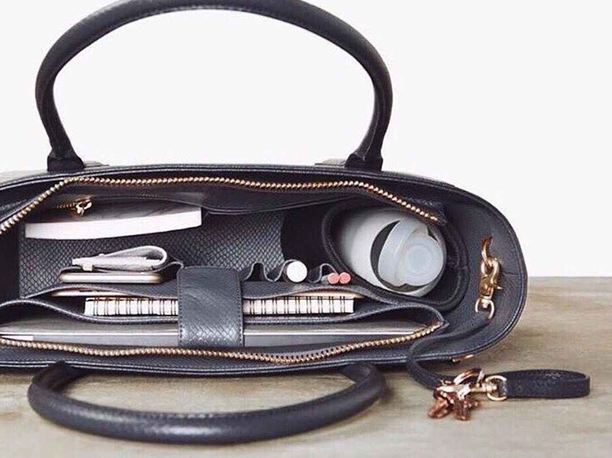
DVD Projection: the advert
What is your opinion about the work bag for ladies?

