Slide 1
What time is it?
REVISION

Slide 2
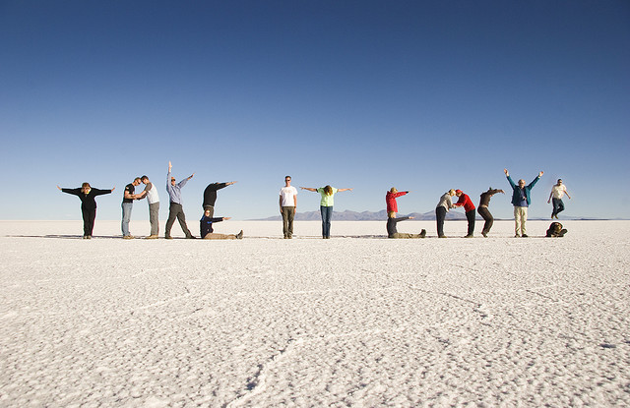
str. 28

Slide 3
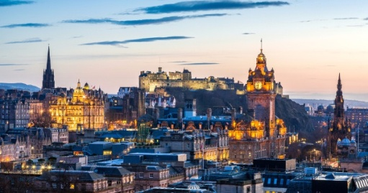
Edinburgh
str. 29, T 4.2

Slide 4
str. 29, T 4.2

Slide 6
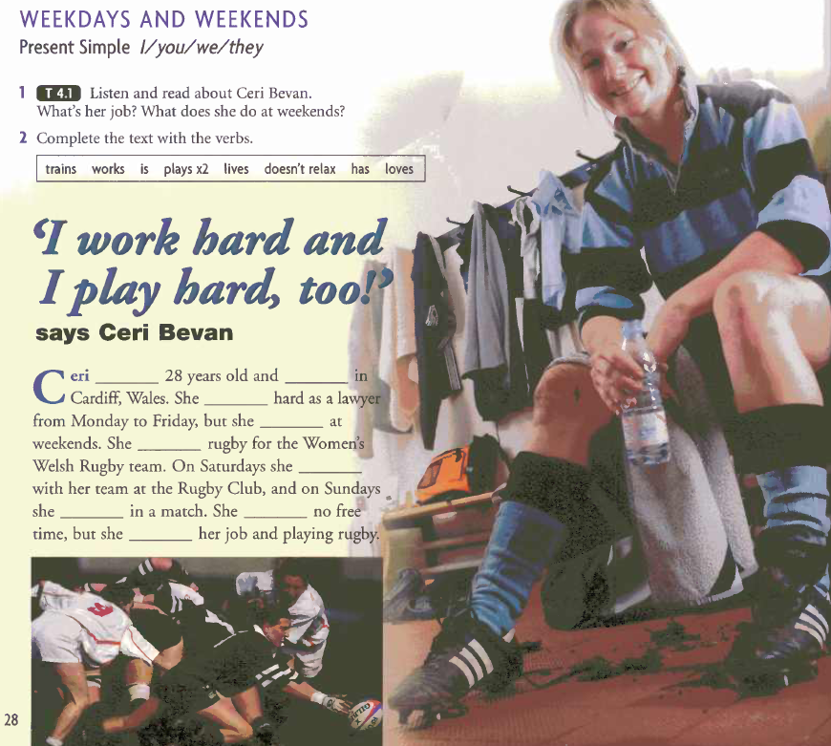

Slide 7
str. 30, T 4.4

Slide 8
str. 30, T 4.5

Slide 9
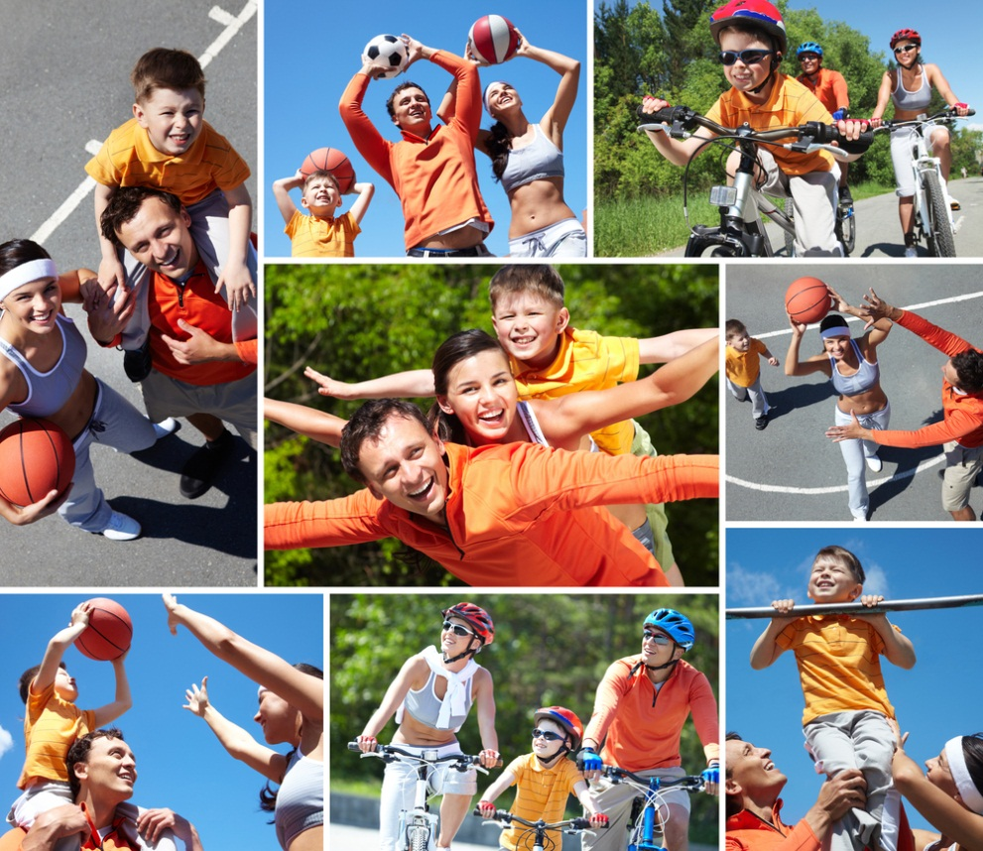
Tick your favourite leisure activities:
str. 30

Slide 12
Thank you for your attention! See you next time! ☺

