Slide 1
Practice classes
15 March, 2018

Slide 2
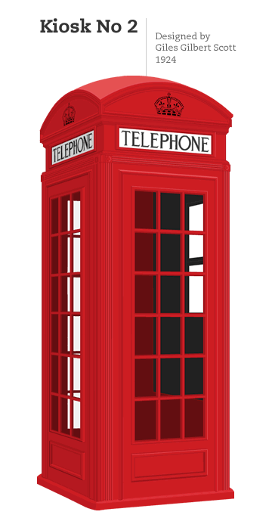
Red telephone box in England– crvena telefonska govornica u Engleskoj
find it on the streets of the United Kingdom, Malta, Bermuda and Gibraltar
a British cultural icon
in red colour

Slide 3
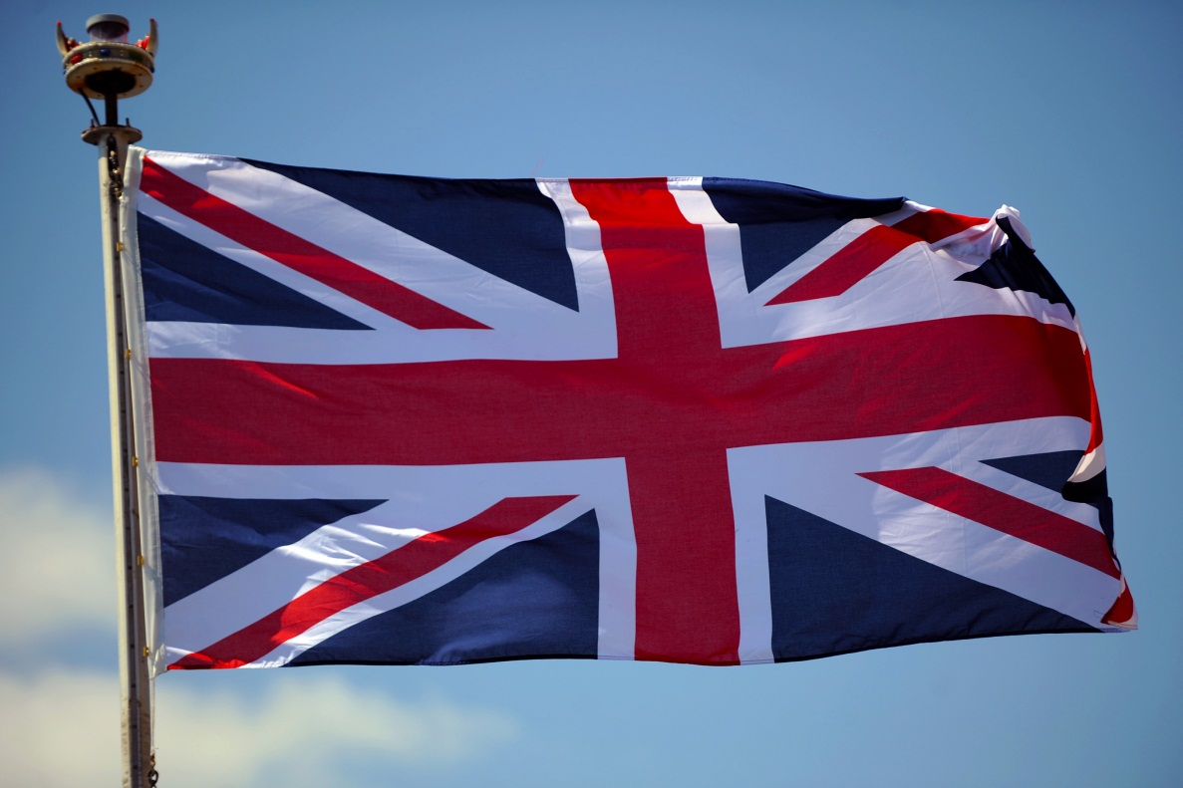
Zastava Velike Britanije "Junion Džek"
The Union Jack Flag
Colours
(royal) blue,
red
white
Popular culture

Slide 4
Lists (15 points)
Final review, page 80

Slide 5
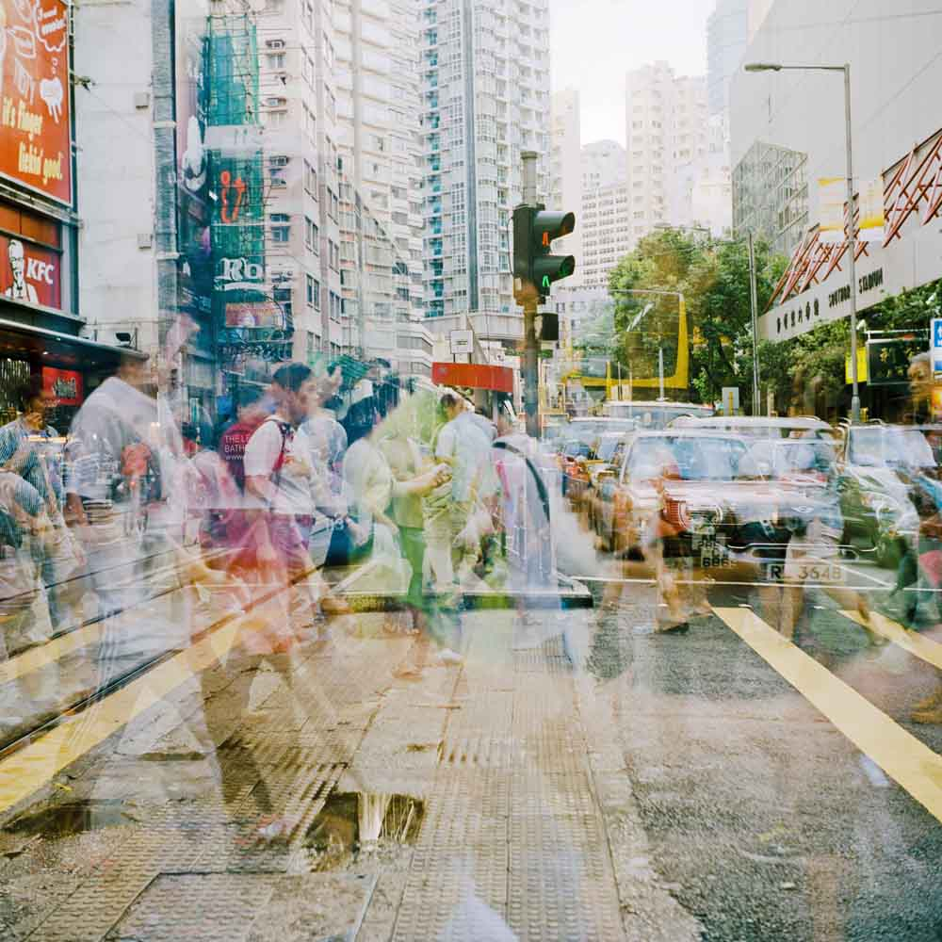
People and places

Slide 6
Thank you for your attention!
See you next class!

